Slide 1

The road to Atlantis
RIGHT PAST THAT BEND BEYOND TEMPORAL COUPLING LANE
Indu Alagarsamy
@indu_alagarsamy
indu@bitsnbytes.us

Slide 2
Our search for Atlantis
What motivates us?
What are we trying to solve?
Beautiful code == few lines of code?

Slide 3
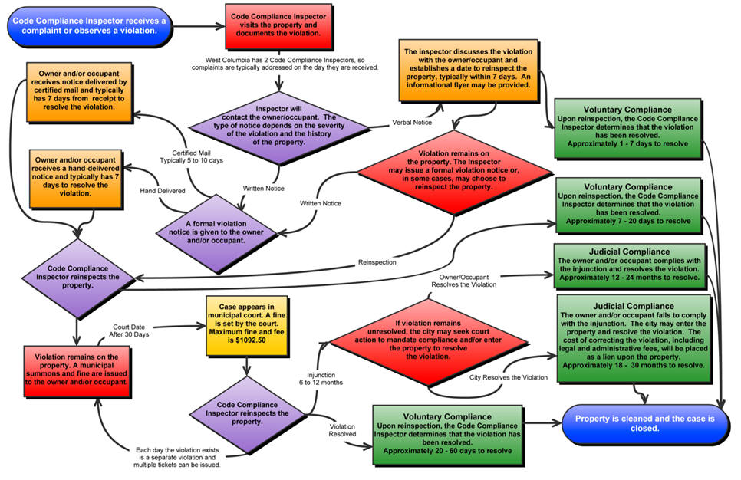
The call stack way of thinking!

Slide 4
And what we end up with – Services calling one another
//Step 1: Create an instance of the WCF proxy.
CalculatorClient client = new CalculatorClient();
// Step 2: Call the service operations. Call the Add service operation.
double value1 = 100.00D;
double value2 = 15.99D;
double result = client.Add(value1, value2);
//Step 3: Closing the client gracefully closes the connection and cleans up resources.
client.Close();

Slide 5
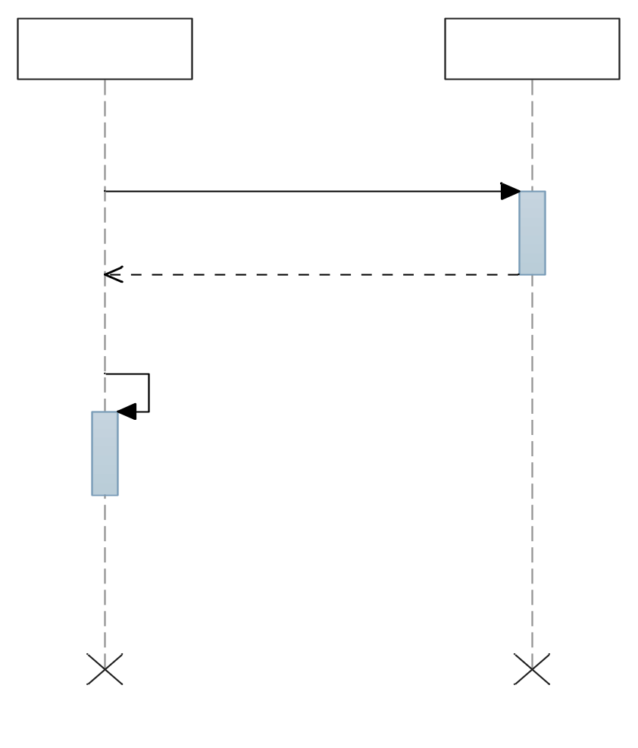
Temporal Coupling
When one part of the system is dependent on the other to be around, in order to fulfill its operation.
But, but.. What if?

Slide 6
Temporal Coupling – What If?
What if B is not around?
What if the call timed out on A, but completed on B?
What if you retry? Are there any bad consequences?

Slide 7
Some traits of good architecture
  Is reliable where it needs to be
  Is simple
  Extends with the business needs.
  Is capable of growing along with the business needs to scale

Slide 8
Good architecture is SRENE
S – Solid
R – Redundant
E – Equalized
NE – No Extension

Slide 9
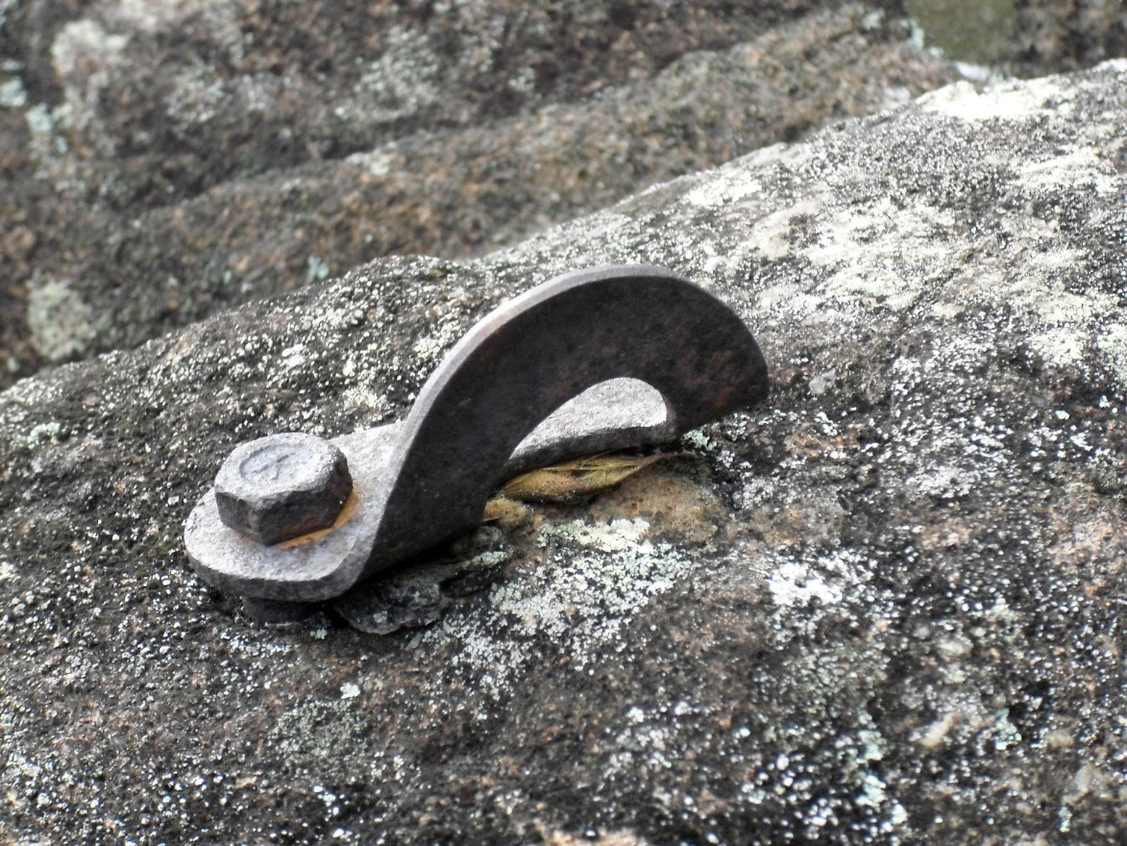
Strong
Built off of solid components

Slide 10
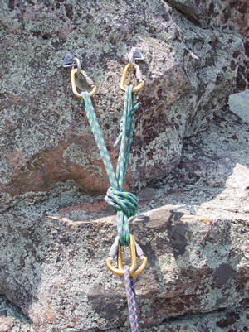
Redundant
When one part of the system fails, the whole system does not fall flat on its face!

Slide 11
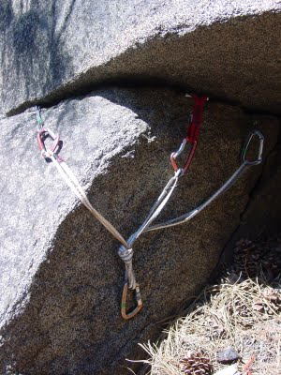
Equalized
Distribute load equally.
To increase strength of the overall system and to decrease the chance of failure

Slide 12
No Extension
If a component fails, then it must not shock load the rest of the system.

Slide 13
Going back . . .

Slide 14
Light at the end of the tunnel!
The world operates on events
Just why shouldn’t the software we write?
Why so rigid?
There is no call stack when dealing with time.

Slide 15

A world of events, a message bus and Pub/Sub!
Software talking to software conveying a certain something happened using messages!
Subscribes to OrderAccepted
Subscribes to ClientBecamePreferred
Customer Relations
Sales
Publishes ClientBecamePreferred
Publishes OrderAccepted

Slide 16
Publish / Subscribe
Makes the design explicit about the staleness of the data and data is eventually consistent.
Makes extensibility easier.

Slide 17
Problem to Solve
Orders can be placed via web, phone or email.
Preferred customers can get a certain discount
When customer orders exceed a certain limit, customers are made preferred

Slide 18
Easier said than done??
Let’s do it!
Let’s implement a bus based solution using NServiceBus

Slide 19
Strong – Redundant - Equalized – No Extension
Handling requirement Changes - "When a customer's status is upgraded, they get a complimentary fee waived one year Hertz Gold membership“
Handling load increases.
What if the CRM piece is down? Does it impact the order piece of the puzzle?

Slide 20
Atlantis does exist!
Questions?
Need more information on NServiceBus?
http://particular.net/documentation/nservicebus
http://particular.net/DiscussionGroup
http://particular.net/HandsOnLabs

